Slide 1
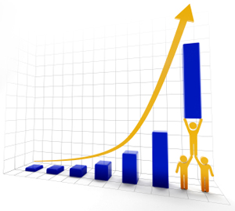
"HR Analytics"PROJECT-P117( AI Varient)
Mentor :
Dipti Sinha
Pushpraj Rathore
Group Members:
Mr. Rajeev Sahukar
Mr. Shalom Sandeep Outa
Ms. Teja Nikku
Mr. Anshul Kumar
Ms. Madhavi Surisetty

Slide 2
Data Driven
Review the data and get familiar with the columns, rows, and data types of the HR_1 and HR_2 Excel files.
Merge the data based on a common column using Power Query and clean the data by removing irrelevant or duplicate data, correcting errors, and ensuring the data is in the right format.
Determine key metrics based on the questions you need to answer or insights to communicate.
Create interactive KPIs, dashboards, and visualizations in Excel, Power BI, and Tableau to communicate insights to stakeholders.

Slide 3
AVERAGE ATTRITION RATE FOR ALL DEPARTMENTS
AVERAGE HOURLY RATE OF MALE RESEARCH SCIENTIST
ATTRITION RATE VS MONTHLY INCOME STATS
AVERAGE WORKING YEARS FOR EACH DEPARTMENT
JOB ROLE VS WORK LIFE BALANCE
ATTRITION RATE VS YEAR SINCE LAST PROMOTION RELATION
KPI_6
KPI_5
KPI_4
KPI_3
KPI_2
KPI_1

Slide 4
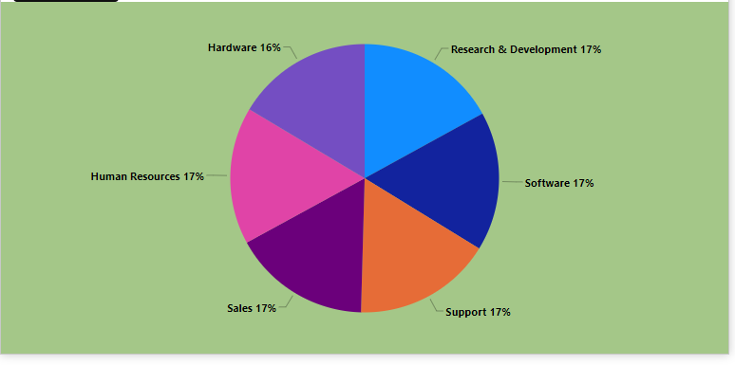
AVERAGE ATTRITION RATE FOR ALL DEPARTMENTS
A pie chart has been created based on the provided data that shows 6 departments with an attrition rate of "yes" and a total of 25,105 employees.
The average attrition rate for these 6 departments is 4,184.17.
The minimum attrition rate among these 6 departments is Hardware with an attrition rate of 4,039 (16%).
The maximum attrition rate among these 6 departments is Research & Development with an attrition rate of 4,260 (17%).

Slide 5
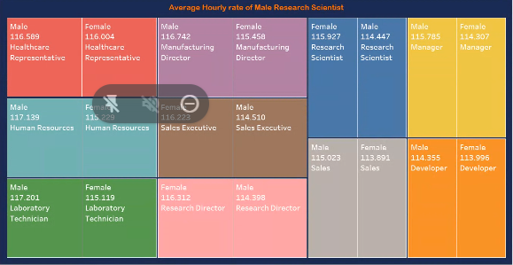
AVERAGE HOURLY RATE OF MALE RESEARCH SCIENTIST
The data shows the sum of hourly rates for job roles broken down by gender.
The blue color represents male Research Scientists, with an average hourly rate of 114.45.
The minimum and maximum hourly rates are 113.89 and 117.20, respectively.

Slide 6
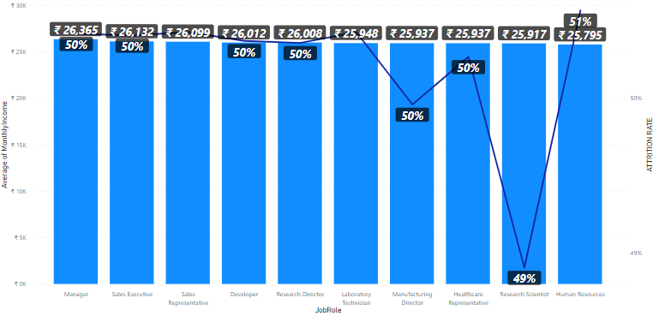
ATTRITION RATE VS MONTHLY INCOME STATS
The Human Resources department has the lowest monthly income of 25,795 and the highest attrition rate of 50.6%.
The Manager job role has a higher monthly income compared to others, with an attrition rate of 50.4%.
The minimum and maximum monthly incomes are 1,001 and 50,999 .

Slide 7
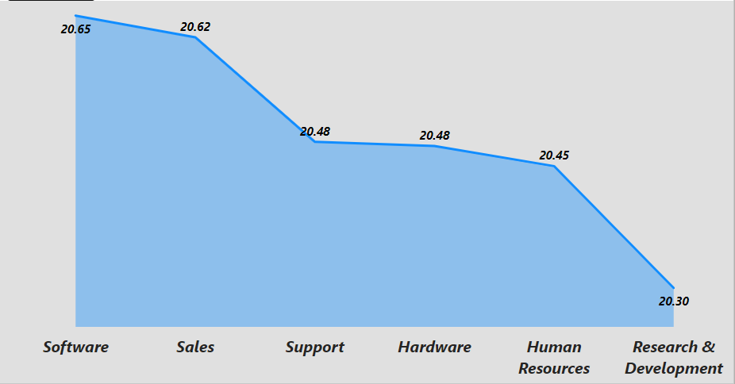
AVERAGE WORKING YEARS FOR EACH DEPARTMENT
These insights are based on the area chart created from the provided data.
The average total working years across all employees is 20.50.
The Research & Development department has the minimum average of 20.30 total working years.
The Software department has the maximum average of 20.65 total working years.
These insights are based on the area chart created from the provided data.
The average total working years across all employees is 20.50.
The Research & Development department has the minimum average of 20.30 total working years.
The Software department has the maximum average of 20.65 total working years.
These insights are based on the area chart created from the provided data.
The average total working years across all employees is 20.50.
The Research & Development department has the minimum average of 20.30 total working years.
The Software department has the maximum average of 20.65 total working years.

Slide 8
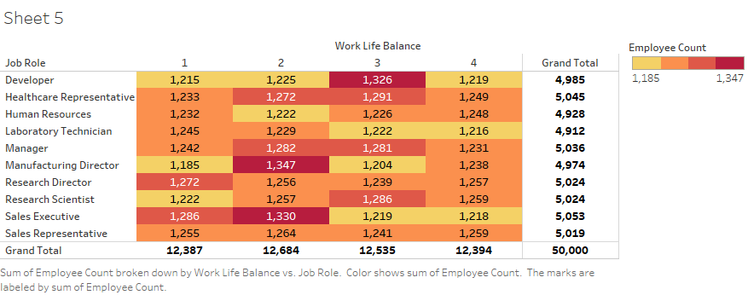
JOB ROLE VS WORK LIFE BALANCE
The total employee count of 50,000 and an average of 1,250 employees per category.
The minimum employee count in a category is 1,185, and the maximum is 1,347.
Manufacturing Directors have the highest and lowest ratings for work-life balance, with 2 and 1 ratings, respectively, based on their employee counts.
The majority of employees gave a 2 rating for work-life balance, with a total employee count of 12,684.

Slide 9
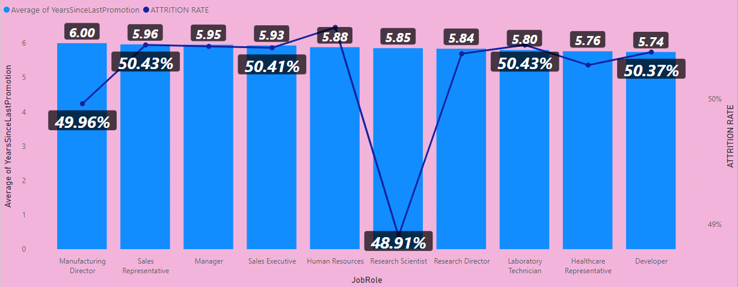
ATTRITION RATE VS YEAR SINCE LAST PROMOTION RELATION
Attrition ranges from 10.07% to 9.74% across different job roles.
The average promotion for employees is between 5.74 to 6.00 years.
The Human Resource department has the highest attrition rate of 10.07% with an average of 5.88 years since last promotion.
Research Scientists have the lowest attrition rate of 9.74% with an average of 5.85 years since last promotion.
Manufacturing Directors have the highest average years since last promotion of 6.0 years and an attrition rate of 9.95%.
Developers have the lowest average years since last promotion of 5.74 years and an attrition rate of 10.03%.

Slide 10
CONCULSION
The dataset consists of 50,000 employees, with 24,941 females and 25,059 males. The Marital Status distribution is Divorced (16,616), Married (16,681), and Single (16,703).
Except for the Software and Support departments, all other departments have a higher attrition rate for married employees.
The Research and Development department has the highest attrition rate (17%), and the Hardware department has the lowest (16.4%).
The average hourly rate, daily rate, and monthly rate of all employees are 115.43, 798.68, and 4 lakhs, respectively.
The highest and average percentage salary hike are 49% and 24.62%, respectively.
Managers have an average monthly income of about 26,365.30, while the Human Resource department has the least at 25,794.76.
The Software department has the highest average working years of about 20.65 (16.79%), while the Research and Development department has the lowest at 20.30 (16.51%).
The Work-Life balance rating of most employees falls under the 2 rating, ranging from 1-4, with about 12,684 employees.
The Research and Development department has the 2nd lowest monthly income, highest performance rating, lowest working years, and the highest attrition rate (17%).

Slide 11


